Slide 1
Proving AM-GM using Binomial Expansion
Rishikesh Badari
George Chemmala
Notes:
Our presentation will cover how the binomial expansion of (x-1)^2 can prove the AM-GM inequality as well as how the trivial inequality is more useful than many realize.

Slide 2
“A serendipitous path to a famous inequality” in The Mathematical Gazette
by Robert M. Young

Slide 3
Introduction:
Optimization without Calculus

Slide 4
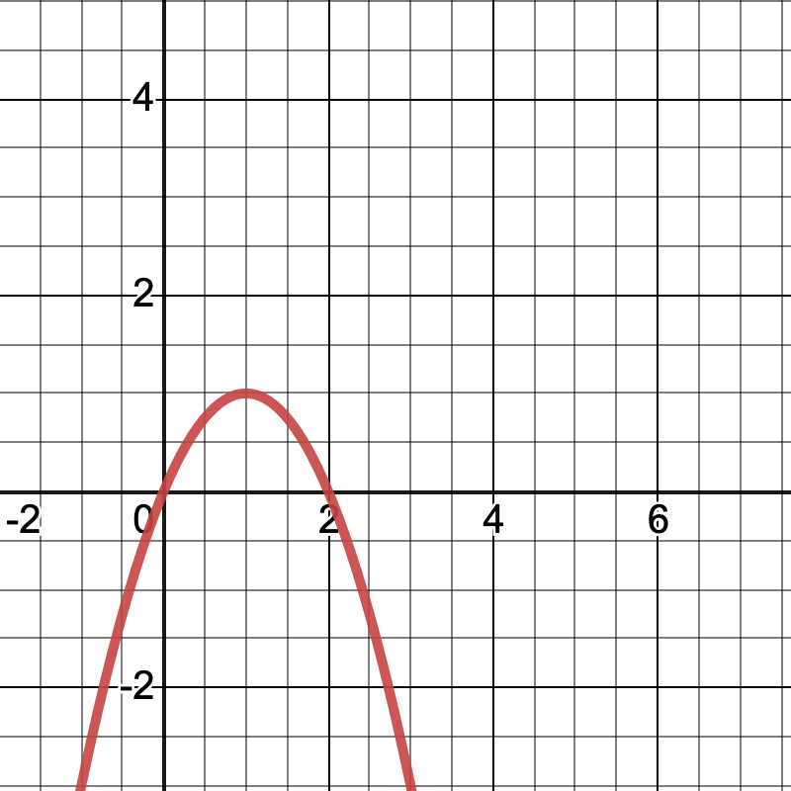
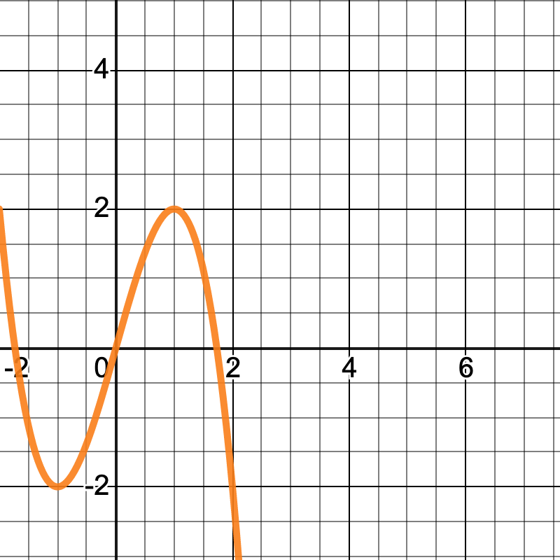
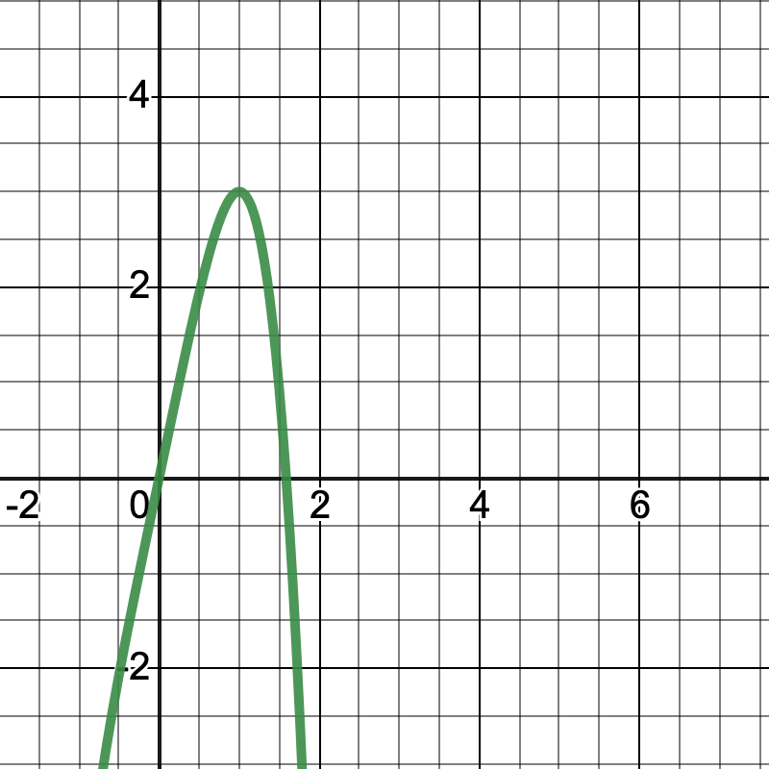
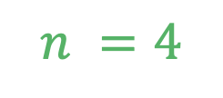
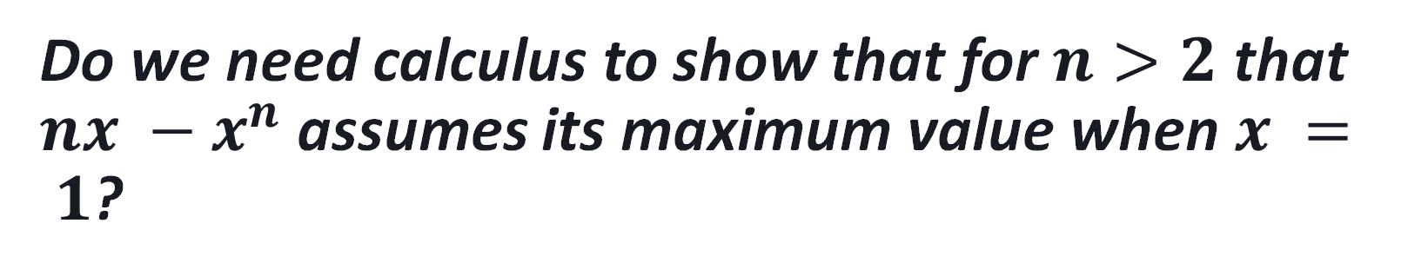
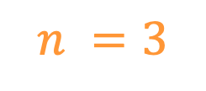
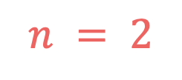
Do we need calculus to show that for $n>2$ that $nx −x^{n}$ assumes its maximum value when $x = 1$?
— From a student studying elementary calculus at Oberlin
$$n = 2$$
$$n =3$$
$$n =4$$

Slide 5



No, we don't
For case $n=2$: $2x−x^{2}$
provable by the Trivial Inequality
$$x^{2}≥0 ⟺x=0$$
$$≈$$
$$x^{2}≥0$$
$$2x − x^{2}$$
$$=−\left(x^{2}−2x+1\right)+1$$
$$=1−{(x−1)}^{2}$$
$$1−{(x−1)}^{2}$$
Maximized when x = 1
Max
Always positive

Slide 6



For case $n=3$: $3x−x^{3}$
$$2x − x^{2}=1−{(x−1)}^{2}$$
$$(2x − x^{2})(x+2)=(1−{\left(x−1\right)}^{2})(x+2)$$
$$2x^{2}+4x−x^{3}−2x^{2}=\left(x+2\right)−{\left(x−1\right)}^{2}(x+2)$$
$$4x−x^{3}=x+2−{\left(x−1\right)}^{2}(x+2)$$
$$3x−x^{3}=2−{\left(x−1\right)}^{2}\left(x+2\right)$$
Maximized when x = 1
Multiplying both sides by $(x+2)$
Max
Always positive

Slide 7



For case $n=4$: $4x−x^{4}$
$$2x − x^{2}=1−{(x−1)}^{2}$$
$$(2x − x^{2})(x^{2}+2x +3)=(1−{\left(x−1\right)}^{2})(x^{2}+2x +3)$$
$$2x^{3}+4x^{2}+6x−x^{4}−2x^{3}−3x^{2}=(x^{2}+2x +3)−{\left(x−1\right)}^{2}(x^{2}+2x +3)$$
$$6x−x^{4}=2x+3−{\left(x−1\right)}^{2}(x^{2}+2x +3)$$
$$4x−x^{3}=3−{\left(x−1\right)}^{2}\left(x^{2}+2x +3\right)$$
Maximized when x = 1
Multiplying both sides by $(x^{2}+2x +3)$
Max
Always positive

Slide 8
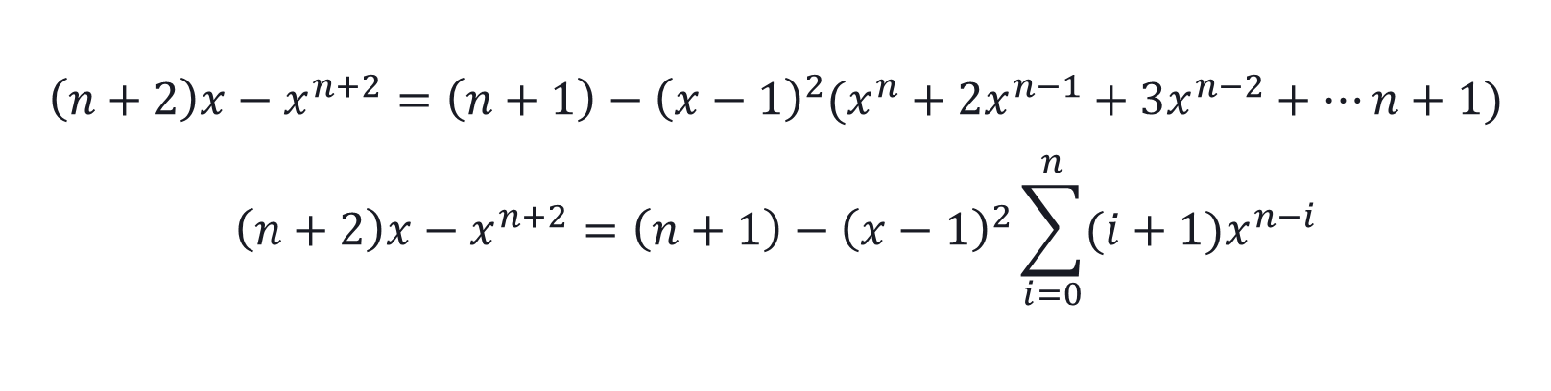
General Formula
$$\left(n+2\right)x−x^{n+2}=\left(n+1\right)−{\left(x−1\right)}^{2}(x^{n}+2x^{n−1}+3x^{n−2}+…n+1)$$
$$\left(n+2\right)x−x^{n+2}=\left(n+1\right)−{\left(x−1\right)}^{2}\sum_{i=0}^{n}{(i+1)x^{n−i}}$$

Slide 9

Proof of General Formula
$\left(n+2\right)x−x^{n+2}=\left(n+1\right)−\left(x^{2}−2x+1\right)\left(x^{n}+2x^{n−1}+3x^{n−2}+…n+1\right)$
$\left(n+2\right)x−x^{n+2}=\left(n+1\right)−(\left(x^{n+2}+2x^{n+1}+3x^{n}+…\left(n+1\right)x^{2}\right)−2 \left(x^{n+1}+2x^{n}+3x^{n−1}+…x\left(n+1\right)\right)+\left(x^{n}+2x^{n−1}+3x^{n−2}+…n+1\right))$
$\left(x^{2}−2x+1\right)\sum_{i=0}^{n}{(i+1)x^{n−i}}$
$\sum_{i=0}^{n}{(i+1)x^{n−i+2}} −2\sum_{i=0}^{n}{\left(i+1\right)x^{n−i+1}}+\sum_{i=0}^{n}{\left(i+1\right)x^{n−i}}$
$\sum_{i=0}^{n}{ix^{n−i+2}+x^{n−i+2}} −2\sum_{i=0}^{n}{ix^{n−i+1}+x^{n−i+1}}+\sum_{i=0}^{n}{ix^{n−i}+x^{n−i}}$
$\sum_{i=0}^{n}{ix^{n−i+2}+x^{n−i+2}} −2\sum_{i=0}^{n}{ix^{n−i+1}+x^{n−i+1}}+\sum_{i=0}^{n}{ix^{n−i}+x^{n−i}}$
$x^{n+2}−\left(n+1\right)+\left(n+2\right)x$

Slide 10
Proof:
AM-GM Inequality

Slide 11
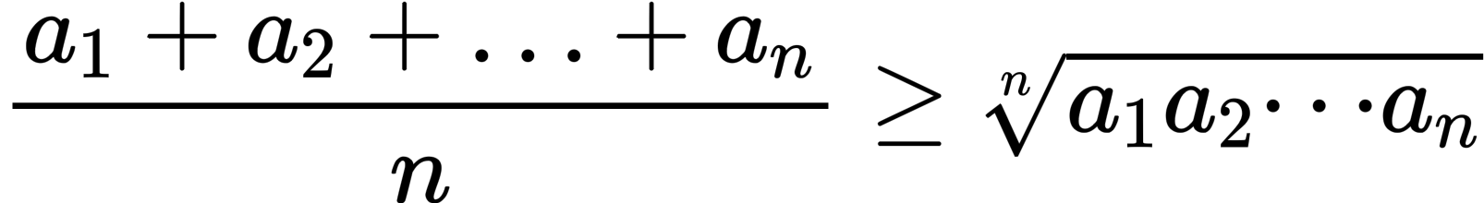
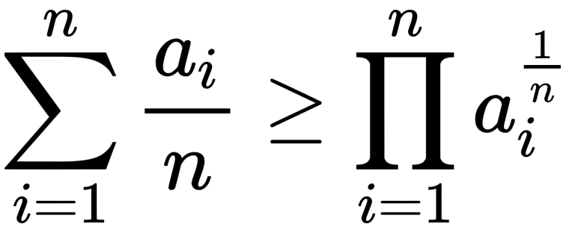
The AM-GM Inequality

Slide 12
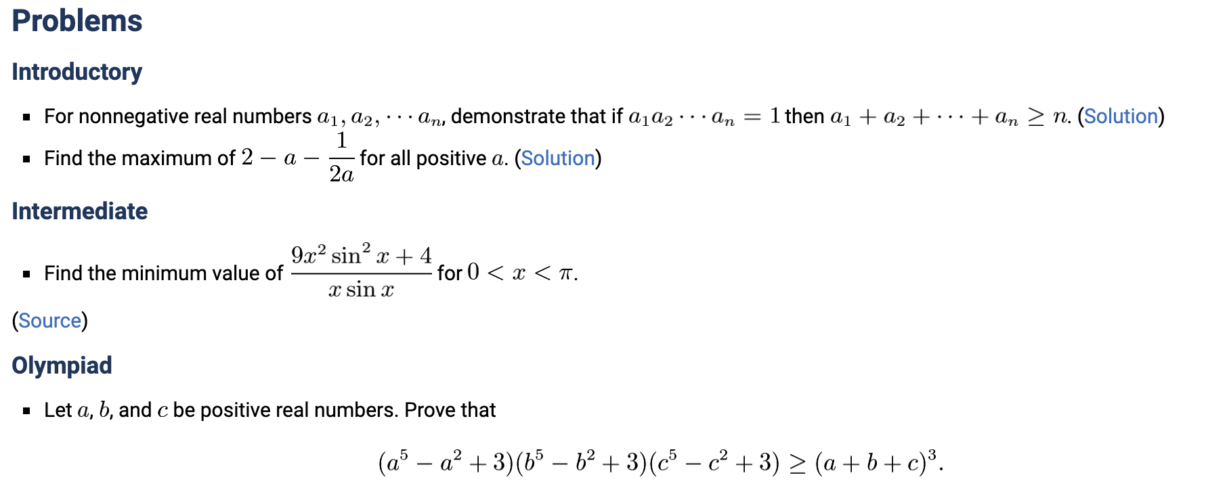
*Art of Problem Solving

Slide 13
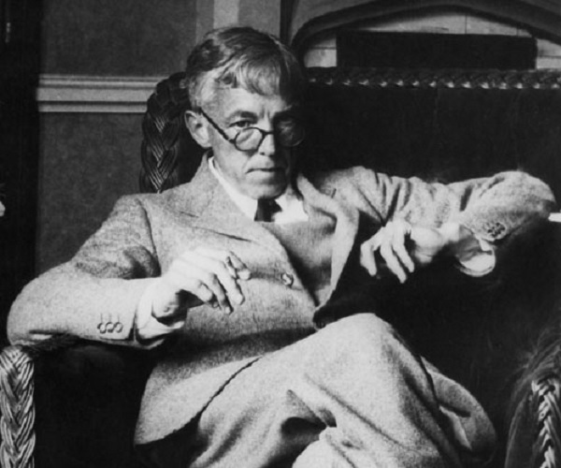
G. H. Hardy
Thought of Inequalities as:
"bright"
"amusing"
"intelligible without large reserves of knowledge"
Notes:
G.H. Hardy

Slide 14
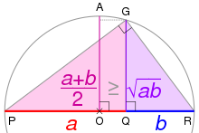
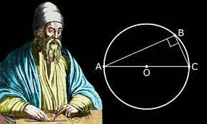
Euclid's elements

Slide 15
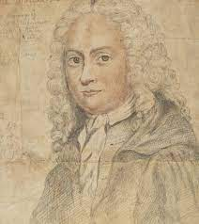
Maclaurin first recorded statement of the AM-GM Inequality

Slide 16
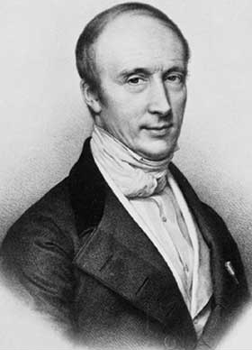
Cauchy used induction

Slide 17
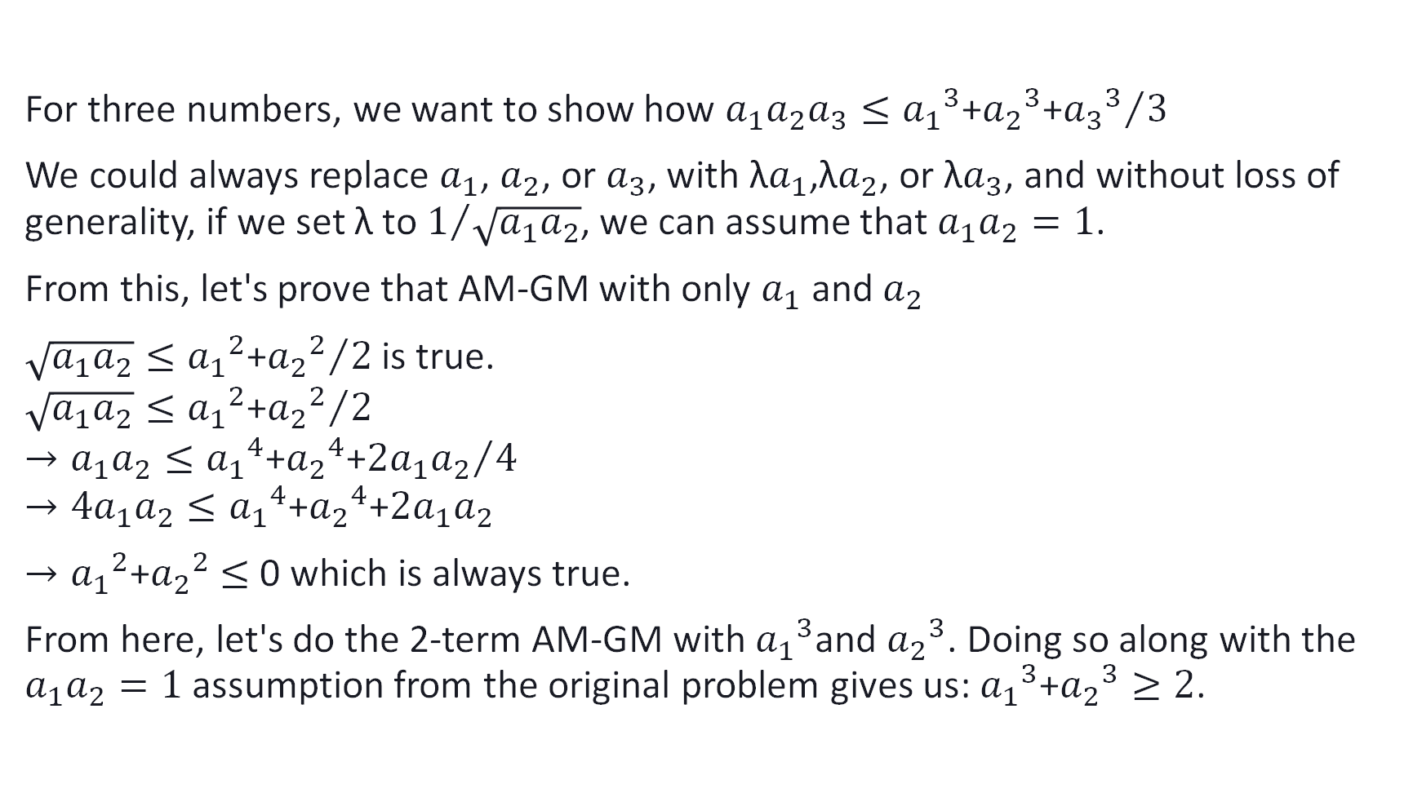
Proof of the AM-GM inequality
For three numbers, we want to show how $a_{1}a_{2}a_{3}≤{{a_{1}}^{3}\text{+}{a_{2}}^{3}\text{+}{a_{3}}^{3}}/3$
We could always replace $a_{1}$, $a_{2}$, or $a_{3}$, with ${\text{λ}a}_{1}$,λ$a_{2}$, or ${\text{λ}a}_{3}$, and without loss of generality, if we set λ to $1/{\sqrt{a_{1}a_{2}}}$, we can assume that $a_{1}a_{2}=1$.
From this, let's prove that AM-GM with only $a_{1}$ and $a_{2}$
$\sqrt{a_{1}a_{2}}≤{{a_{1}}^{2}\text{+}{a_{2}}^{2}}/2$is true.
$$\sqrt{a_{1}a_{2}}≤{{a_{1}}^{2}\text{+}{a_{2}}^{2}}/2$$
$$→a_{1}a_{2}≤{{a_{1}}^{4}\text{+}{a_{2}}^{4}\text{+}{2a}_{1}a_{2}}/{4 }$$
$$→4a_{1}a_{2}≤{a_{1}}^{4}\text{+}{a_{2}}^{4}\text{+}{2a}_{1}a_{2}$$
$→{a_{1}}^{2}\text{+}{a_{2}}^{2}$ $≤$ 0 which is always true.
From here, let's do the 2-term AM-GM with ${a_{1}}^{3}$and ${a_{2}}^{3}$. Doing so along with the $a_{1}a_{2}=1$ assumption from the original problem gives us: ${a_{1}}^{3}\text{+}{a_{2}}^{3}≥2$.

Slide 18
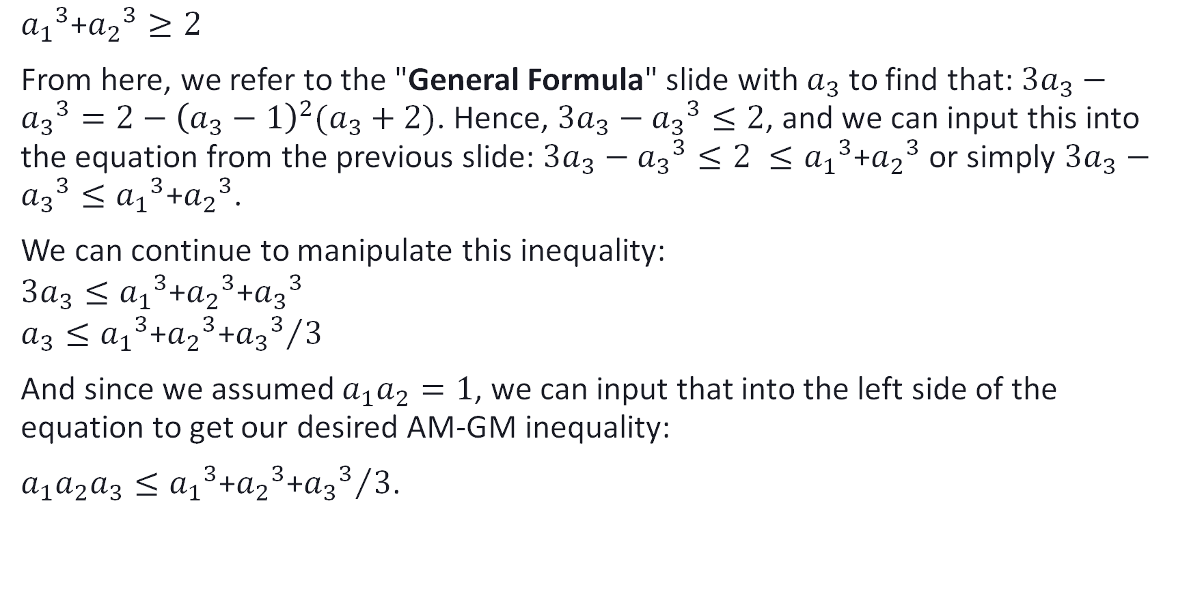
Continuation
$${a_{1}}^{3}\text{+}{a_{2}}^{3}≥2$$
From here, we refer to the "General Formula" slide with $a_{3}$to find that: ${3a}_{3}−{a_{3}}^{3}=2−{\left(a_{3}−1\right)}^{2}(a_{3}+2)$. Hence, ${3a}_{3}−{a_{3}}^{3}≤2$, and we can input this into the equation from the previous slide: ${3a}_{3}−{a_{3}}^{3}≤2 ≤{a_{1}}^{3}\text{+}{a_{2}}^{3}$ or simply ${3a}_{3}−{a_{3}}^{3}≤{a_{1}}^{3}\text{+}{a_{2}}^{3}$.
We can continue to manipulate this inequality:
$${3a}_{3}≤{a_{1}}^{3}\text{+}{a_{2}}^{3}\text{+}{a_{3}}^{3}$$
$$a_{3}≤{{a_{1}}^{3}\text{+}{a_{2}}^{3}\text{+}{a_{3}}^{3}}/3$$
And since we assumed $a_{1}a_{2}=1$, we can input that into the left side of the equation to get our desired AM-GM inequality:
$a_{1}a_{2}a_{3}≤{{a_{1}}^{3}\text{+}{a_{2}}^{3}\text{+}{a_{3}}^{3}}/3$.

Slide 19
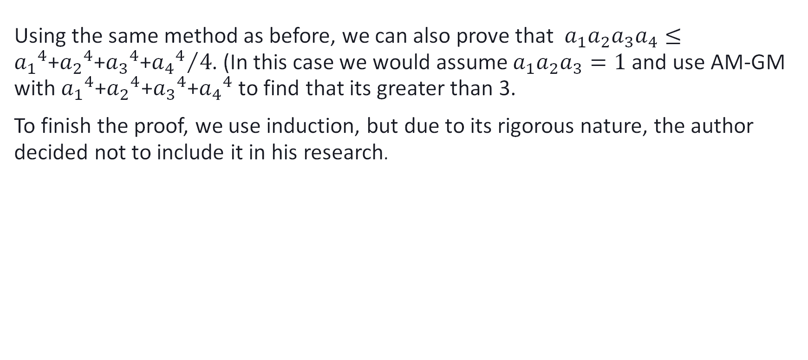
Continuation
Using the same method as before, we can also prove that $a_{1}a_{2}a_{3}a_{4}≤{{a_{1}}^{4}\text{+}{a_{2}}^{4}\text{+}{a_{3}}^{4}\text{+}{a_{4}}^{4}}/4$. (In this case we would assume $a_{1}a_{2}a_{3}=1$ and use AM-GM with ${a_{1}}^{4}\text{+}{a_{2}}^{4}\text{+}{a_{3}}^{4}\text{+}{a_{4}}^{4}$to find that its greater than 3.
To finish the proof, we use induction, but due to its rigorous nature, the author decided not to include it in his research.

Slide 20
Application:
Example

Slide 21
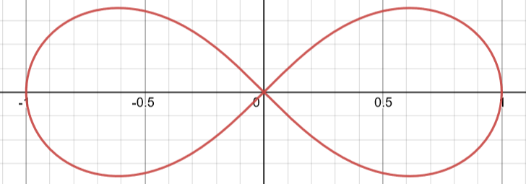

Example 1: maximum value of a lemniscate in the first quadrant
$$\text{Lemniscate}: r^{2}=\cos{2θ}$$

Slide 22
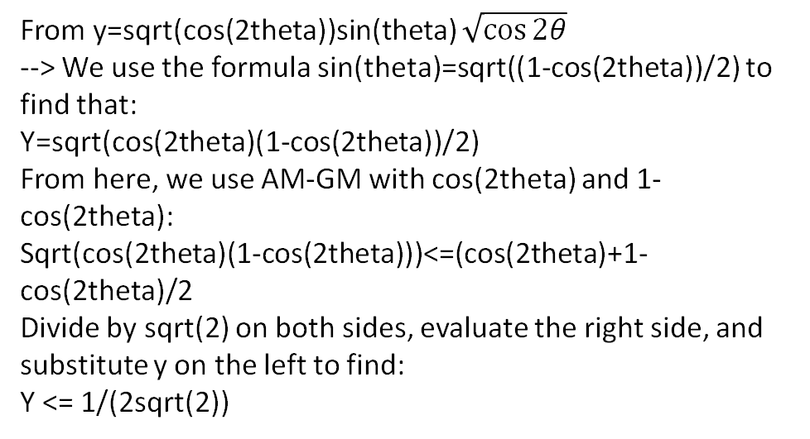

A solution with Calculus
A solution without Calculus and with the AM-GM Inequality
$$r^{2}=cos⁡2θ$$
$$r=\sqrt{cos⁡2θ }$$
$$r\sin{θ}=\sqrt{cos⁡2θ }\sin{θ}$$
$$y=\sqrt{cos⁡2θ }\sin{θ}$$
From here, we'd set the derivative to zero …
From y=sqrt(cos(2theta))sin(theta) $\sqrt{\cos{2θ}}$
--> We use the formula sin(theta)=sqrt((1-cos(2theta))/2) to find that:
Y=sqrt(cos(2theta)(1-cos(2theta))/2)
From here, we use AM-GM with cos(2theta) and 1-cos(2theta):
Sqrt(cos(2theta)(1-cos(2theta)))<=(cos(2theta)+1-cos(2theta)/2
Divide by sqrt(2) on both sides, evaluate the right side, and substitute y on the left to find:
Y <= 1/(2sqrt(2))

Slide 23
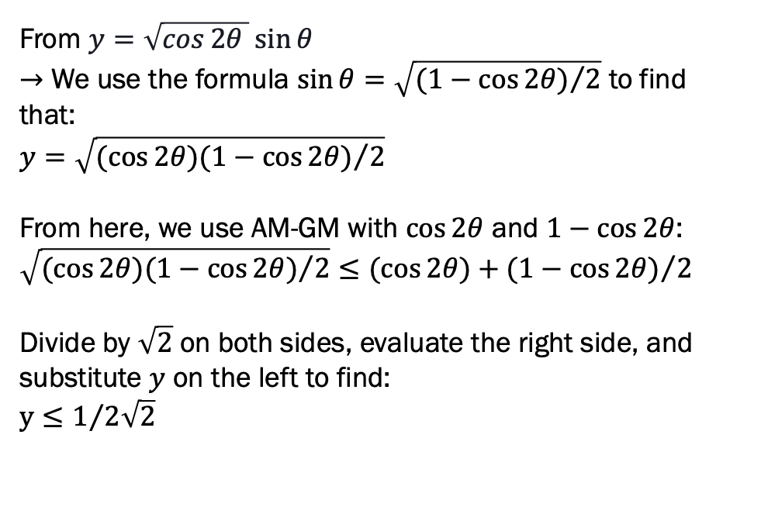
A solution with Calculus
A solution without Calculus and with the AM-GM Inequality
$$r^{2}=cos⁡2θ$$
$$r=\sqrt{cos⁡2θ }$$
$$r\sin{θ}=\sqrt{cos⁡2θ }\sin{θ}$$
$$y=\sqrt{cos⁡2θ }\sin{θ}$$
From here, we'd set the derivative to zero …
From $y=\sqrt{cos⁡2θ }\sin{θ}$
$→$ We use the formula $\sin{θ}=\sqrt{{(1−\cos{2θ})}/2}$ to find that:
$$y=\sqrt{{(cos{2θ})(1−\cos{2θ})}/2}$$
From here, we use AM-GM with $\cos{2θ}$ and $1−\cos{2θ}$:
$$\sqrt{{(cos{2θ})(1−\cos{2θ})}/2}≤{(cos{2θ})+(1−\cos{2θ})}/2$$
Divide by $\sqrt{2}$ on both sides, evaluate the right side, and substitute $y$ on the left to find:
$$y≤1/{2\sqrt{2}}$$

